Slide 1


Slide 2
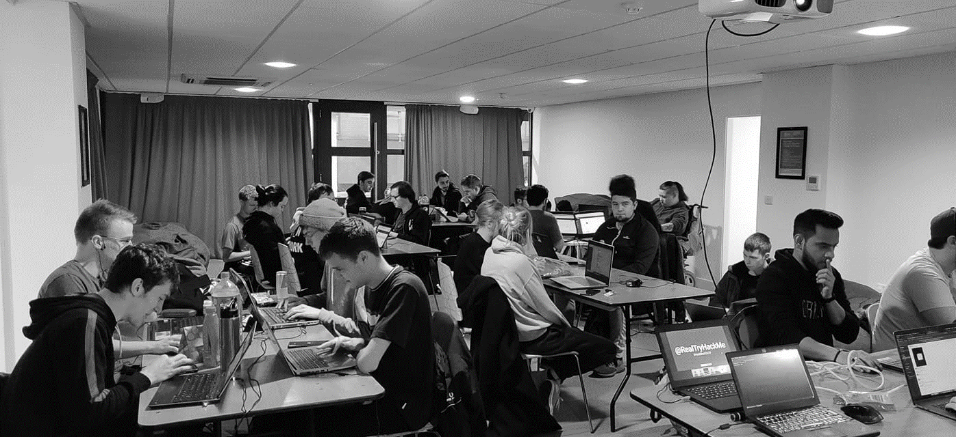



/dmuhackers
@dmuhackers
Introduction

Slide 3



Disclaimer
Don’t do illegal shit

Slide 4
Welcome
We are DMU Hackers (but you already knew that)
I’m sure we said this enough at the Opportunities fair but
We are an Ethical Hacking society teaching you the things your course should probably teach you anyway
What we’re doing tonight
Introducing ourselves
Introducing you to kali
Having a go at learning the ropes to some of the tools
Going to the pub!

Slide 5



Social
A chill one at Soar Point
A few drinks at Firebug
A great time at Oddbar
MOSH? (allegedly)

Slide 6
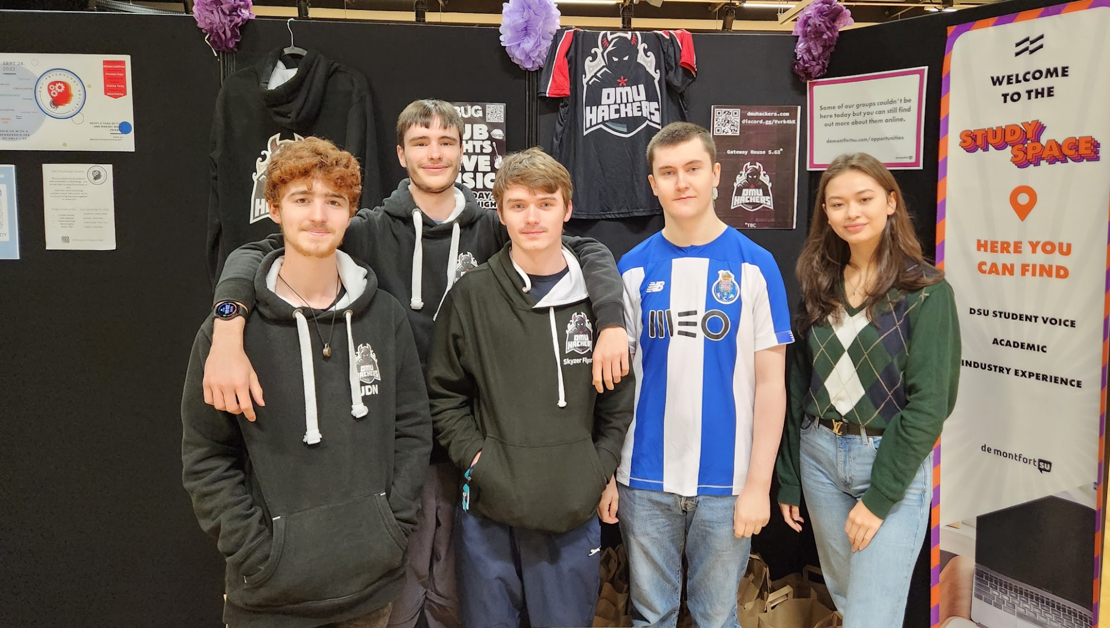
Meeting the Committee

Slide 7

Chairman: Joe
Who Am I?
3rd Year Cyber Security Student
Summer Placement at Lockheed Martin
Got into hacking through Cyber Discovery program
Mosh regular
Interests: APIs, Programming, Reverse Engineering, Gaming, Alcohol
Fun Fact: Hacked Xbox Live for a bug bounty

Slide 8
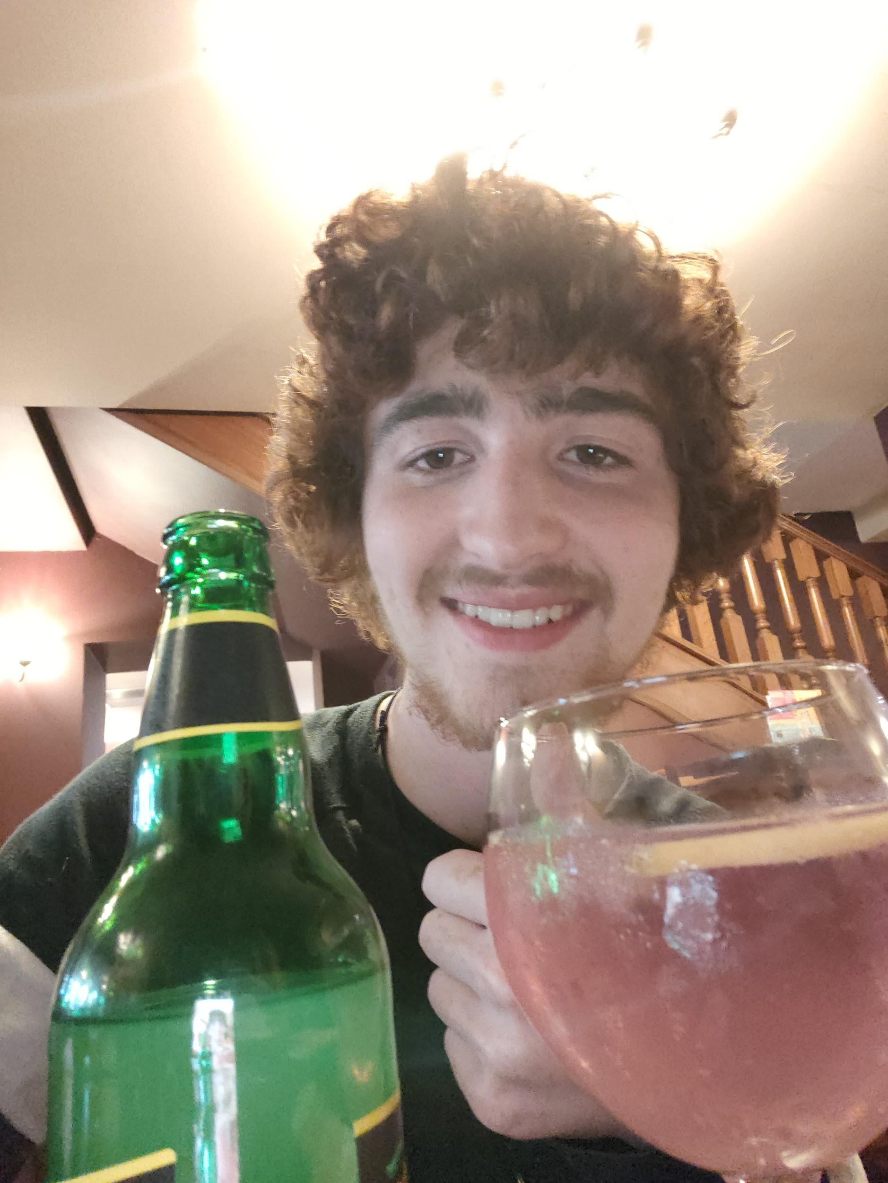
Secretary: Jordon
Who Am I?
3rd Year Cyber Student
I’ve been a full time linux user for 7 years
Got into Penetration Testing a few years ago when my friend taught me the ropes
Rep the merch more often than a normal person should
Interests: OSINT, Arduino, Tabletop, Gaming, Anime, Alcohol
Fun Fact: I can talk your ear off about obscure lore from various franchises ranging from Half Life to Ben 10

Slide 9
Health And Safety: Dilan
Who Am I?
2nd Year Computer Science student
Unix user always
CastingShadow on the Discord
Interests: Pentesting, OS & App Development, Sound Engineering, Quantum Engineering/Mechanics
Fun Fact: I believe that there is a program for everything.

Slide 10
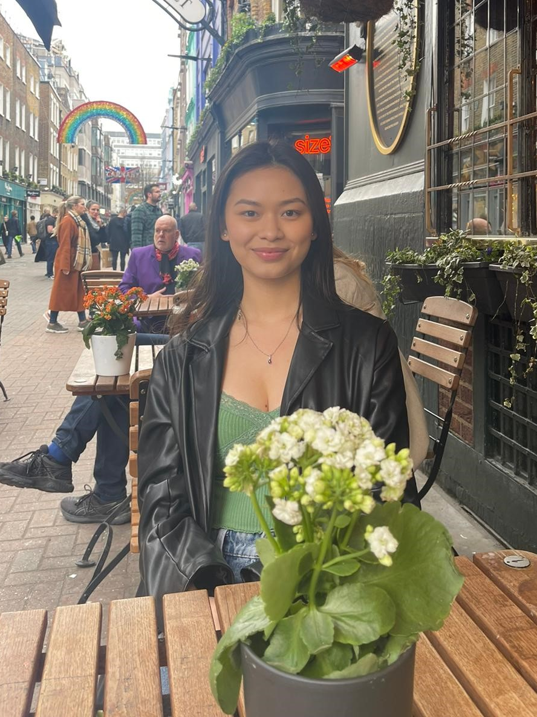
Treasurer: Becca
Who Am I?
3rd Year Cyber Security Student
Placement at NEXT Retail
Interests: OSINT, Sims 4, blue team, badminton
Fun fact: I’m half Thai, half English, and grew up in Singapore. This is why I sometimes sound American

Slide 11
Social Sec: Seth
Who Am I?
2nd year cyber security student
mosh disliker
Interests: Basketball Russian literature and cryptography
Fun Fact: I have visited the Stasi H.Q.

Slide 12

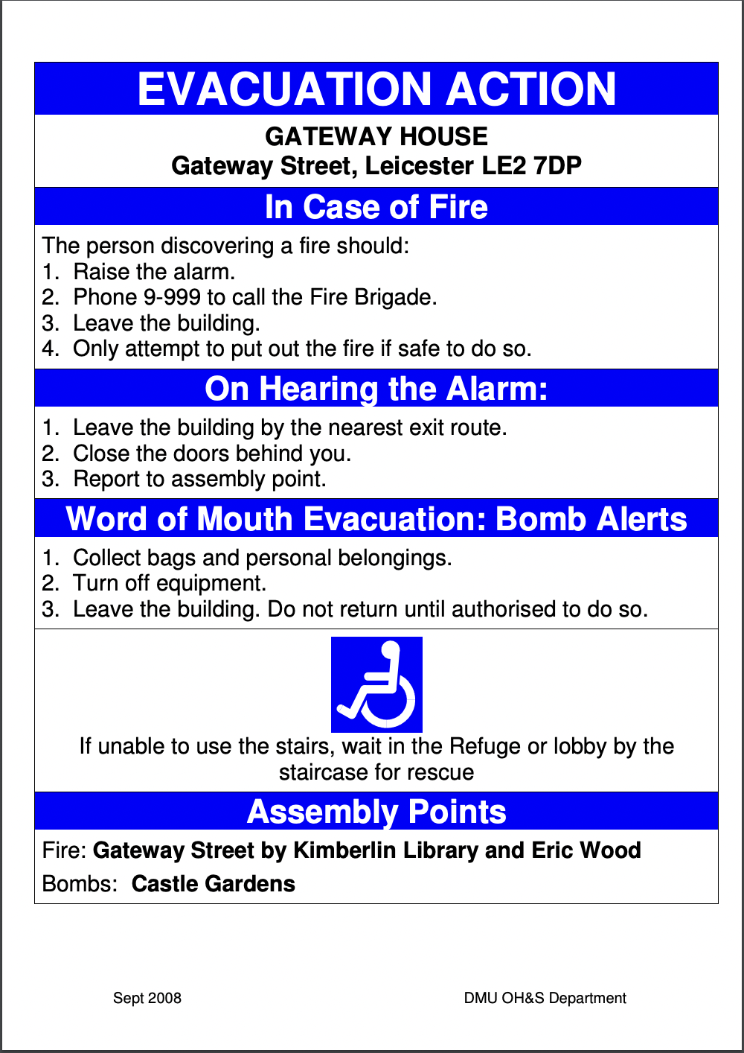


Fire Safety

Slide 13

Kali And Virtual Machines
Kali Linux is a penetration testing suite that comes preloaded with a bunch of tools that we can used to scan and exploit systems.
Examples include
nmap - Scanning open ports on a target
gobuster - Scanning directories and pages on a webserver
Alternatives include dirbuster and ffuf
nth - name that hash, helps identify how data has been hashed
hashcat and johntheripper - hash cracking software
BurpSuite - web app security testing software
Metasploit - massive exploit database
Don’t Be Silly! Always check QR codes go where you expect.
https://github.com/DMUHackers

Slide 14
Kali And Virtual Machines
Virtual Machines are a virtualized environment that allows you to run an entire OS on top of your own.
It’s completely sandboxed.
If set up right, everything that happens inside the VM can’t affect the main (Host) OS
We’ve Set one up for you on the lab machines
Open VirtualBox and launch the DMU Hackers VM
The username and password is kali
Don’t Be Silly! Always check QR codes go where you expect.
https://github.com/DMUHackers

Slide 15
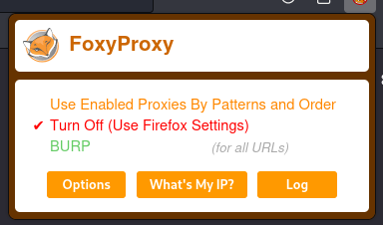
Get a grip with kali
Open up a terminal
$ ping 8.8.8.8
Setup juice-shop
$ sudo juice-shop
Disable FoxyProxy
Notes:
Ping - checks internet connectivity
Juice-shop - Auto open juice shop in their browser
FoxyProxy - Basics of burp, not too detailed just will probs use later

Slide 16



Resources
TryHackMe - https://tryhackme.com/
HackTheBox - https://www.hackthebox.com/
Cyberstart - https://cyberstart.com/

